Slide 1

Regression Equation for Predicting Water Level

Slide 2
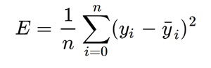
Equation of Linear Regression –
y = mX+c, where m = slope and c = intercept.
This can also be intuitively illustrated as –
m = Model Coefficient for each predictor (Output from the Regression Algorithm)
X = Predictor Value (Rainfall in mm)
c = Regression Line Intercept (Output from the Regression Algorithm)
Our goal is to minimize this error to obtain the most accurate value of m and c.
The regression algorithm iteratively finds out the most optimized value for m and c.

Slide 3
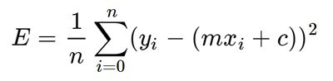
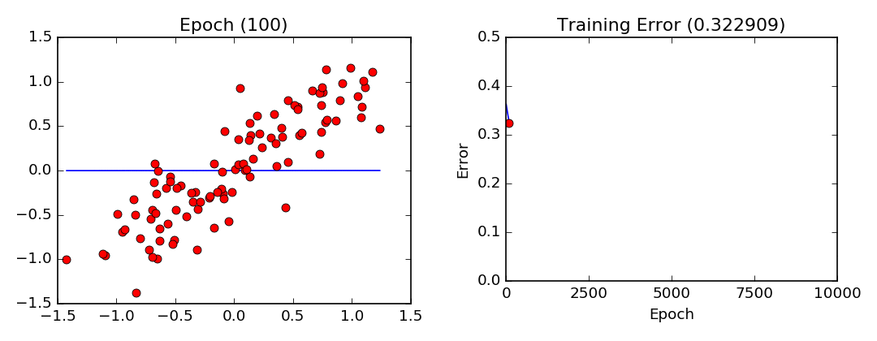
Let's substitute the value of ȳᵢ (Output) :
This will help us in getting the optimized values for the hyper parameters (m and c).

Slide 4
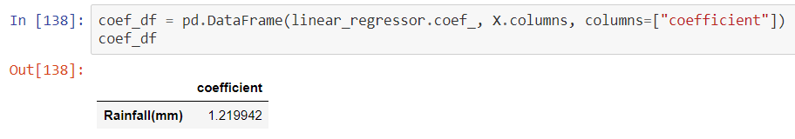
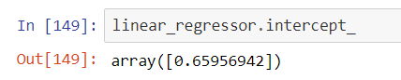
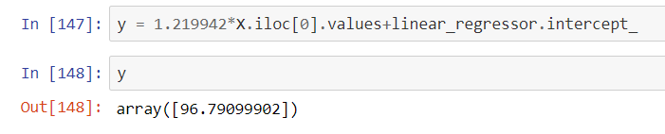
Thus our equation becomes –
y(Rainfall) = model_coefficient(m) * Rainfall value(X) + regression_intercept(c)
Let’s take an example –
Now we have the value of m, let’s see the value of c from our algorithm
Let’s predict a value using the equation -

Slide 5
Further Extension of the Model
The model can be further extended to get more accurate predictions to generate accurate flood alerts –
y = model_coefficient_f1 * Rainfall_value(f1) + model_coefficient_f2 * inflow from glacial lake(f2) + model_coefficient_f3 * snowmelt runoff(f3) + model_coefficient_f4 * frequency of landslide(f4) + … + regression_intercept

Slide 6
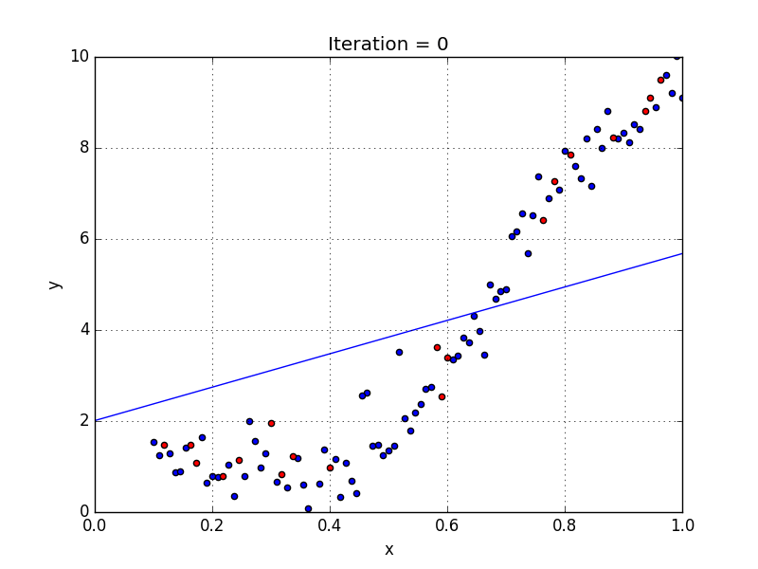
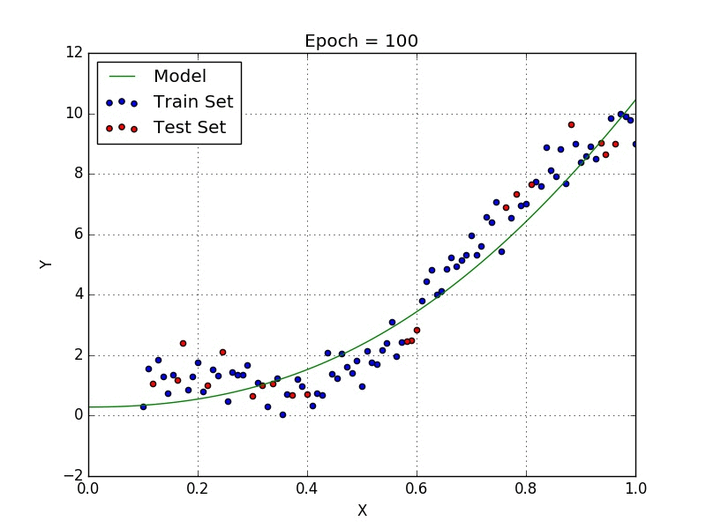
Polynomial Regression based Approach

Slide 7
Flowchart of Accidental Blockage detection models
New features implemented:
Within Indian territory
Beyond Indian territory
Gauge to gauge difference measurement
Landslide detection using AI (Object Detection)

Slide 8
Beyond Indian territory
Landslide detection model trained using custom vision in Azure cloud services
Analyse river basin images captured using remote sensing satellite
Landslide images captured using satellite
Notify the concerned authority if landslide is detected

Slide 9
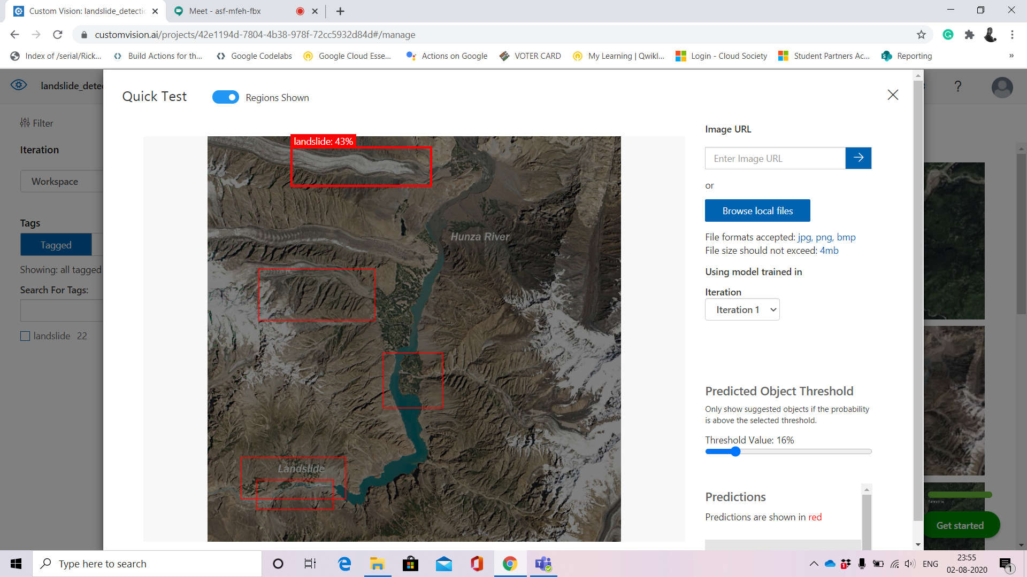
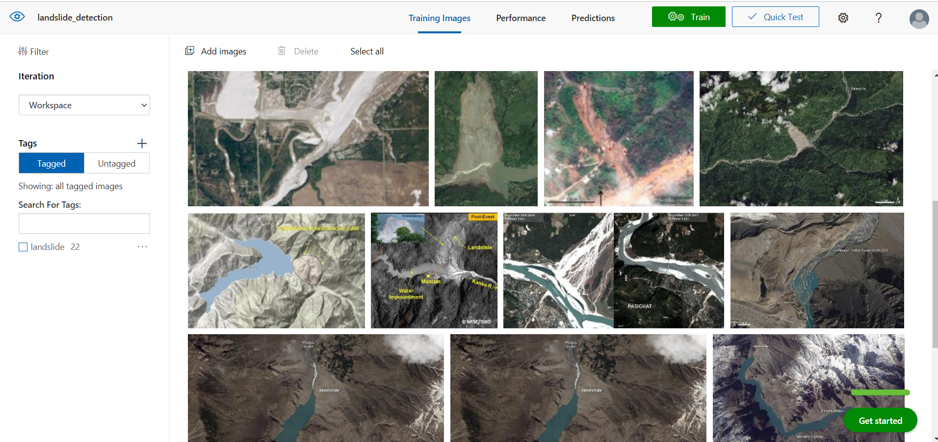
Landslide detection using AI
Training Images
Testing Images

Slide 10
Within Indian territory
Difference in reading is constant?
Gauge to gauge differential measurement
yes
Implies normal flow of water
Blockage in flow of water detected
no
Calculate travel time of discharged water if outburst takes place
Calculate volume of water accumulated using sensor reading

Slide 11
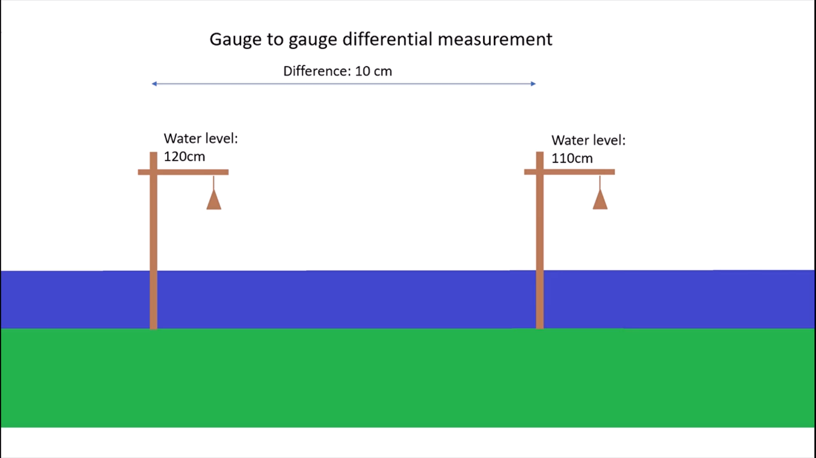

Slide 12
Scenarios considered for prediction: Rainfall only
Data set used | Machine learning model | Input data provided | Output obtained
Rainfall
Rainfall vs Water level linear regression
Rainfall forecast obtained from Weather API
Expected rise in reservoir level due to forecasted rainfall
Water level rise

Slide 13
Scenarios considered for prediction : Both snow fall and rainfall
Data set used | Machine learning model | Input data provided | Output obtained
Amount of snow fall
Rainfall forecast obtained from Weather API
Snowfall, temperature and rainfall vs Water level linear regression
Air temperature
Snow fall forecast obtained from Weather API
Expected rise in reservoir level due to forecasted rainfall
Rainfall amount
Air forecast obtained from Weather API
Water level rise

Slide 14
Scenarios considered for prediction : Glacial lake outburst flood
Dataset used | Machine learning model | Input data provided | Output obtained
Computer vision based model to asses the volume of water held by lake
Satellite imagery of Glacial lake at different times of year
Live image feed captured using remote sensing satellite
Authorities are made aware of the possible outburst

Slide 15
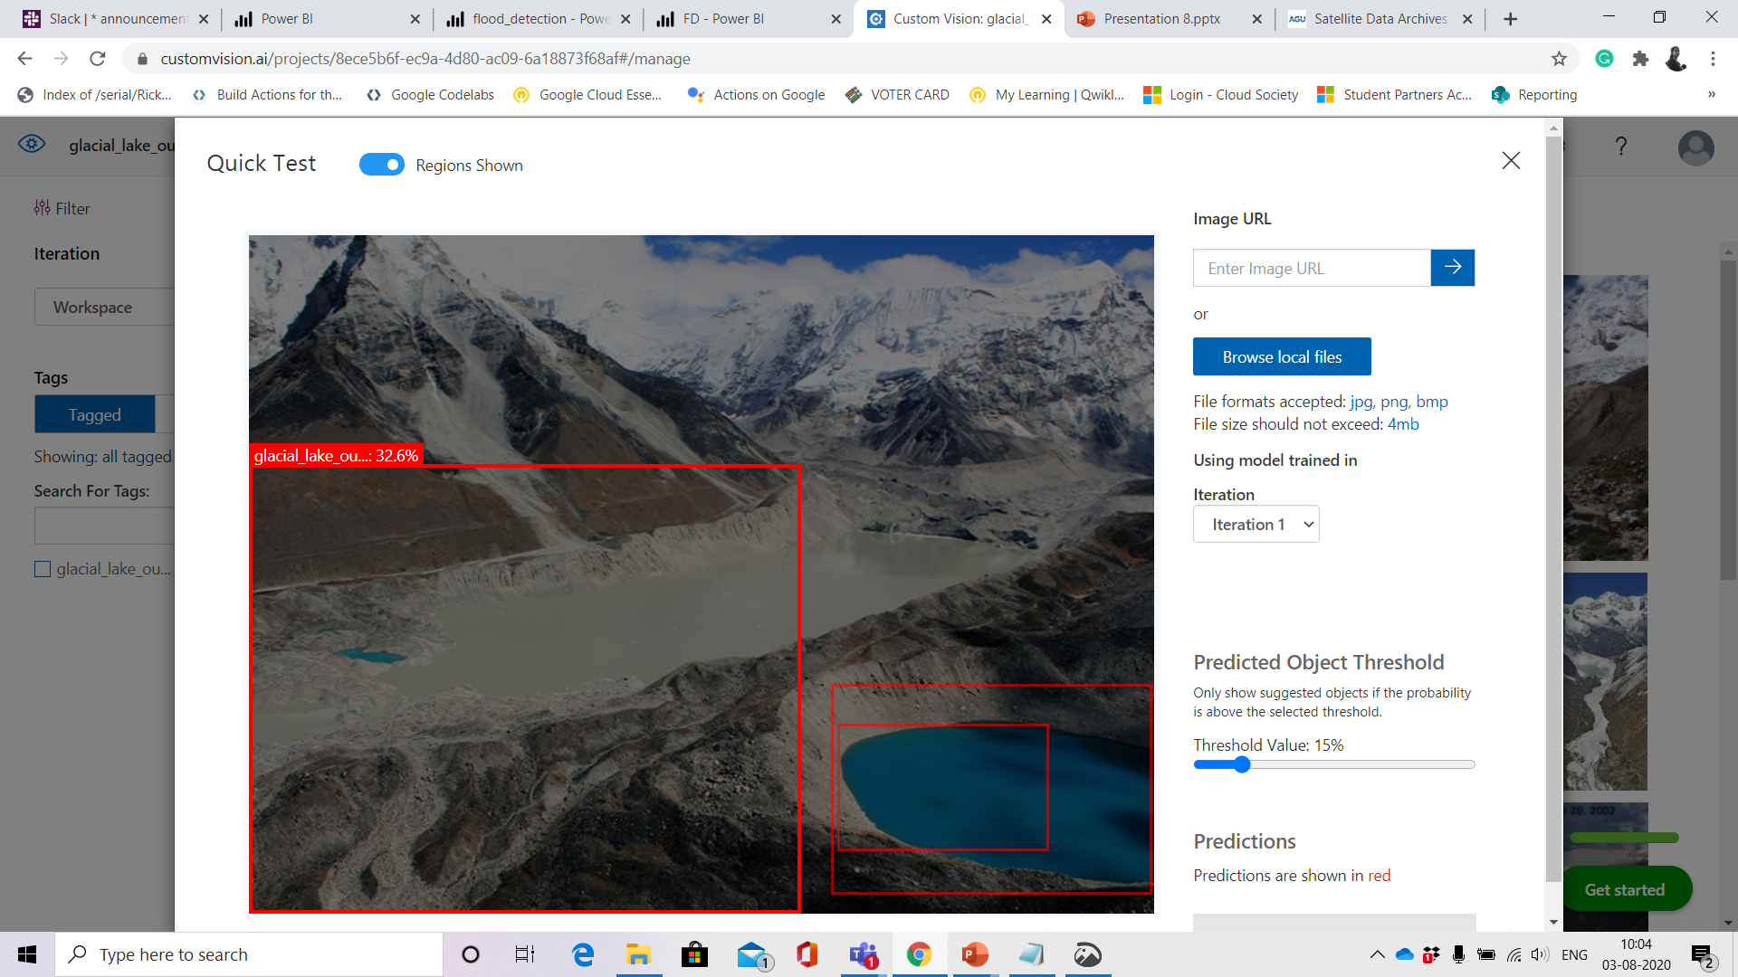
Glacial lake detected using AI (object detection)

Slide 16
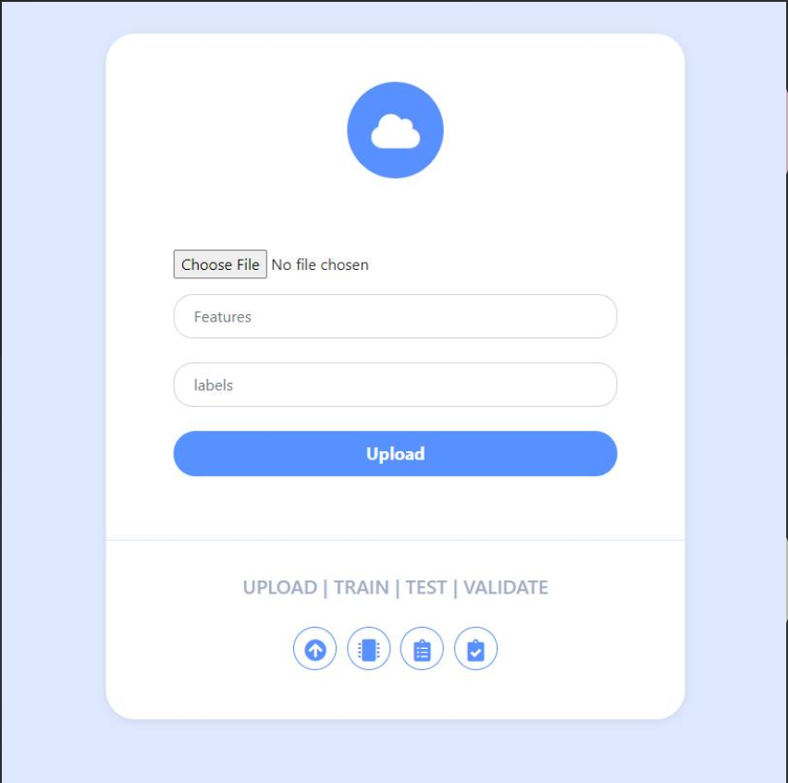
A screenshot of an UI where you can upload new features, labels and dataset, which will train automatically
*under development

Slide 17
New parameter testing schematic
CSV dataset
Input by user
Features and label column values
Push to Database
API
Retrain a model using the new parameters
Show the result in dashboard for visualisation

Slide 18
What have we done?
Local dashboard (using React)​
Central dashboard (using PowerBI)​
Public address system: 1. SMS 2. Call alert 3. Tweet 4. E-mail 5. Light pattern.​
Machine Learning to predict rise in water level and issue alert, terms considered: rainfall, inflow volume of water, travel time, corresponding rise in water level for inflow of certain volume of water.​
Artificial intelligence(object detection) to detect landslides through satellite images.​
Flexibility to add new parameter.​

Slide 19
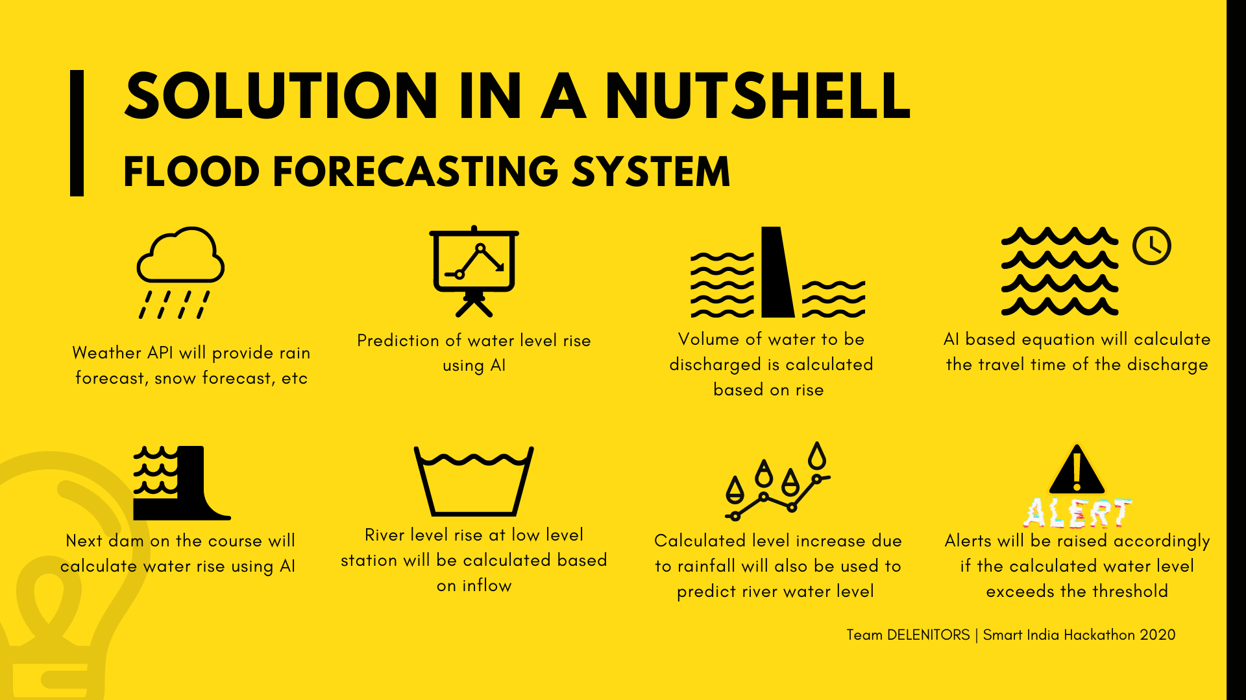
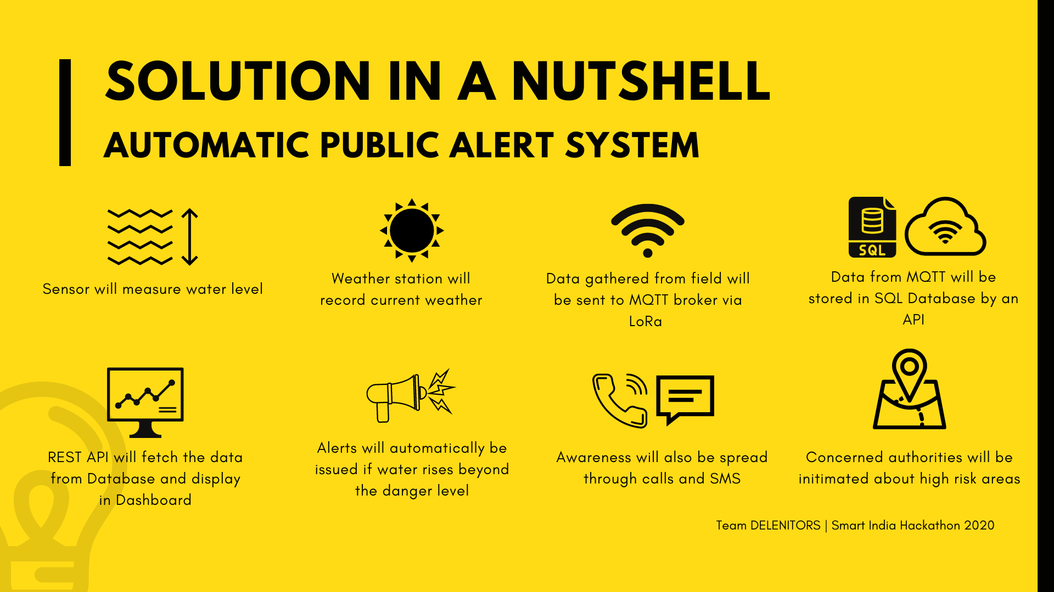
Intelligent Flood Warning System

